Slide 1


Signals & Systems for Computer Engineering
Prof.Dr. B.Berk ÜSTÜNDAĞ
Istanbul Technical University
Faculty of Computer Engineering and Informatics
BLG354E / CRN: 21615
6th Week Lecture (cont.)
2020
bustundag@itu.edu.tr
BLG354E / CRN: 21560
3rd Week Lecture

Slide 2


Example:
Block diagram of a 2nd order moving average FIR filter is given below.
Find its step response
Write the transfer function in terms of unit delays ( z⁻¹ )
Find the output if the input signal x[n] is discretized from x(t)=10sin(100πt) by samping at 200Hz
x[n]
A
B
+
y[n]
z⁻¹
z⁻¹
1/3
∑
a)
+
+
Y=B/3+A/3+X/3
z⁻¹→B=A , A=X
1/3
1/3
b)
y[n]=(x[n]+x[n-1]+x[n-2])/3
y[n]=(x[n]+z⁻¹x[n]+z-²x[n])/3
$$T\left(z\right)=\frac{Y(z)}{X(z)}=\frac{1+z^{−1}+z^{−2}}{3}$$
$$T\left(z\right)=\frac{z^{2}+z+1}{3z^{2}}$$
Why is that called FIR Filter ?
What should be the ideal coefficients for a desired frequency response ?
BLG354E - İTÜ Faculty of Computer Engineering and Informatics - Üstündağ

Slide 3
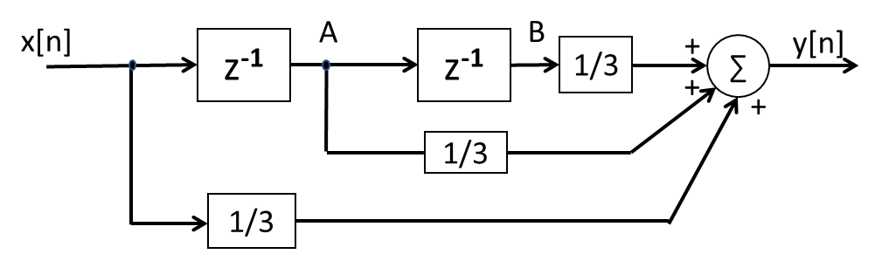
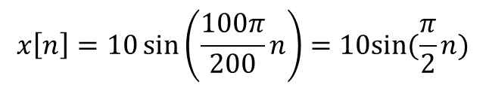
c) T_{s}=1/200 t=n T_{s} =n/200 , n=0,1,2,….
$$x\left[n\right]=10\sin\left(\frac{100π}{200}n\right)=10sin⁡(\frac{π}{2}n)$$
Y=B/3+A/3+X/3
z⁻¹→B=A , A=X
BLG354E - İTÜ Faculty of Computer Engineering and Informatics - Üstündağ

Slide 4


n | X | A | B | Y
0 | 0.000 | 0 | 0 | 0
1 | 7.071 | 0.000 | 0.000 | 2.357
2 | 10.000 | 7.071 | 0.000 | 5.690
3 | 7.071 | 10.000 | 7.071 | 8.047
4 | 0.000 | 7.071 | 10.000 | 5.690
5 | -7.071 | 0.000 | 7.071 | 0.000
6 | -10.000 | -7.071 | 0.000 | -5.690
7 | -7.071 | -10.000 | -7.071 | -8.047
8 | 0.000 | -7.071 | -10.000 | -5.690
9 | 7.071 | 0.000 | -7.071 | 0.000
10 | 10.000 | 7.071 | 0.000 | 5.690
11 | 7.071 | 10.000 | 7.071 | 8.047
12 | 0.000 | 7.071 | 10.000 | 5.690
13 | -7.071 | 0.000 | 7.071 | 0.000
14 | -10.000 | -7.071 | 0.000 | -5.690
15 | -7.071 | -10.000 | -7.071 | -8.047
16 | 0.000 | -7.071 | -10.000 | -5.690
17 | 7.071 | 0.000 | -7.071 | 0.000
$$x\left[n\right]=10sin⁡(\frac{π}{4}n)$$
n | X | A | B | Y
0 | 0.000 | 0 | 0 | 0
1 | 5.000 | 0.000 | 0.000 | 1.667
2 | 8.660 | 5.000 | 0.000 | 4.553
3 | 10.000 | 8.660 | 5.000 | 7.887
4 | 8.660 | 10.000 | 8.660 | 9.107
5 | 5.000 | 8.660 | 10.000 | 7.887
6 | 0.000 | 5.000 | 8.660 | 4.553
7 | -5.000 | 0.000 | 5.000 | 0.000
8 | -8.660 | -5.000 | 0.000 | -4.553
9 | -10.000 | -8.660 | -5.000 | -7.887
10 | -8.660 | -10.000 | -8.660 | -9.107
11 | -5.000 | -8.660 | -10.000 | -7.887
12 | 0.000 | -5.000 | -8.660 | -4.553
13 | 5.000 | 0.000 | -5.000 | 0.000
14 | 8.660 | 5.000 | 0.000 | 4.553
15 | 10.000 | 8.660 | 5.000 | 7.887
16 | 8.660 | 10.000 | 8.660 | 9.107
17 | 5.000 | 8.660 | 10.000 | 7.887
$$x\left[n\right]=10sin⁡(\frac{π}{6}n)$$
Φ_{x}
Φ_{y}
ΔΦ(ω)= Φ_{x}-Φ_{y}
BLG354E - İTÜ Faculty of Computer Engineering and Informatics - Üstündağ

Slide 5

n | X | A | B | Y
0 | 0.000 | 0 | 0 | 0
1 | 6.588 | 0.000 | 0.000 | 2.196
2 | 5.000 | 6.588 | 0.000 | 3.863
3 | 3.071 | 5.000 | 6.588 | 4.886
4 | 8.660 | 3.071 | 5.000 | 5.577
5 | 13.659 | 8.660 | 3.071 | 8.464
6 | 10.000 | 13.659 | 8.660 | 10.773
7 | 5.659 | 10.000 | 13.659 | 9.773
8 | 8.660 | 5.659 | 10.000 | 8.107
9 | 11.071 | 8.660 | 5.659 | 8.464
10 | 5.000 | 11.071 | 8.660 | 8.244
11 | -1.412 | 5.000 | 11.071 | 4.886
12 | 0.000 | -1.412 | 5.000 | 1.196
13 | 1.412 | 0.000 | -1.412 | 0.000
14 | -5.000 | 1.412 | 0.000 | -1.196
15 | -11.071 | -5.000 | 1.412 | -4.886
16 | -8.660 | -11.071 | -5.000 | -8.244
17 | -5.659 | -8.660 | -11.071 | -8.464
18 | -10.000 | -5.659 | -8.660 | -8.106
19 | -13.659 | -10.000 | -5.659 | -9.773
20 | -8.660 | -13.659 | -10.000 | -10.773
21 | -3.071 | -8.660 | -13.659 | -8.464
22 | -5.000 | -3.071 | -8.660 | -5.577
23 | -6.588 | -5.000 | -3.071 | -4.886
24 | 0.000 | -6.588 | -5.000 | -3.863
25 | 6.588 | 0.000 | -6.588 | 0.000
26 | 5.000 | 6.588 | 0.000 | 3.863
27 | 3.071 | 5.000 | 6.588 | 4.886
28 | 8.660 | 3.071 | 5.000 | 5.577
29 | 13.659 | 8.660 | 3.071 | 8.463
30 | 10.000 | 13.659 | 8.660 | 10.773
31 | 5.659 | 10.000 | 13.659 | 9.773
32 | 8.660 | 5.659 | 10.000 | 8.107
33 | 11.071 | 8.660 | 5.659 | 8.464
34 | 5.000 | 11.071 | 8.660 | 8.244
35 | -1.412 | 5.000 | 11.071 | 4.887
36 | 0.000 | -1.412 | 5.000 | 1.196
37 | 1.412 | 0.000 | -1.412 | 0.000
38 | -5.000 | 1.412 | 0.000 | -1.196
39 | -11.071 | -5.000 | 1.412 | -4.886
40 | -8.660 | -11.071 | -5.000 | -8.244
41 | -5.659 | -8.660 | -11.071 | -8.464
42 | -10.000 | -5.659 | -8.660 | -8.106
43 | -13.659 | -10.000 | -5.659 | -9.773
44 | -8.661 | -13.659 | -10.000 | -10.773
45 | -3.071 | -8.661 | -13.659 | -8.464
46 | -5.000 | -3.071 | -8.661 | -5.577
47 | -6.588 | -5.000 | -3.071 | -4.886
48 | 0.000 | -6.588 | -5.000 | -3.863
49 | 6.588 | 0.000 | -6.588 | 0.000
50 | 5.000 | 6.588 | 0.000 | 3.863
51 | 3.071 | 5.000 | 6.588 | 4.886
52 | 8.660 | 3.071 | 5.000 | 5.577
53 | 13.659 | 8.660 | 3.071 | 8.463
54 | 10.000 | 13.659 | 8.660 | 10.773
55 | 5.659 | 10.000 | 13.659 | 9.773
56 | 8.660 | 5.659 | 10.000 | 8.107
57 | 11.071 | 8.660 | 5.659 | 8.463
58 | 5.000 | 11.071 | 8.660 | 8.244
59 | -1.412 | 5.000 | 11.071 | 4.887
60 | 0.000 | -1.412 | 5.000 | 1.196
61 | 1.412 | 0.000 | -1.412 | 0.000
62 | -5.000 | 1.412 | 0.000 | -1.196
63 | -11.071 | -5.000 | 1.412 | -4.886
Input signal x[n]
$$x\left[n\right]=10\sin\left(\frac{π}{12}n\right)+4sin⁡(\frac{π}{2}n)$$
Output signal y[n]
BLG354E - İTÜ Faculty of Computer Engineering and Informatics - Üstündağ

Slide 6
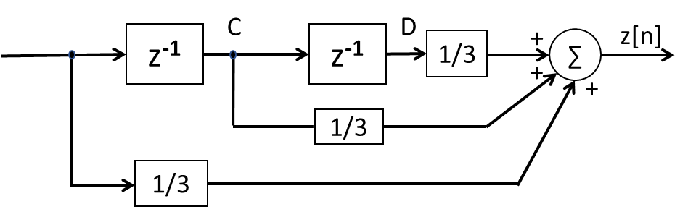

Input signal:
$$x\left[n\right]=10\sin\left(\frac{π}{12}n\right)+4sin⁡(\frac{π}{2}n)$$
Output of the first stage MOV FIR:
Output of the second stage MOV FIR:
BLG354E - İTÜ Faculty of Computer Engineering and Informatics - Üstündağ

Slide 7
Questions:
How is the dependency between phase response of the system and the applied signal properties ?
How is the dependency between frequency response of the system and the applied signal properties ?
How can we determine the system transfer function which performs the desired frequency response ?
How can we define the discrete time system that performs the equivalent transfer function designed for CT signals ?
How can we implement software that performs the desired frequency response on an embedded digital device?
Answers: Chapter 7+

Slide 8







Linear Time-Invariant (LTI) Systems
Linearity and time-invariance are two most important properties in classification of the systems.
Input-output relationship of an LTI system can be described in terms of convolution operation.
Impulse Response:
Response of the continuous-time LTI system when the impulse δ(t) signal is applied to its input, called the impulse response and denoted by “h(t)”:
The system is time invariant →
Continuous-time LTI systems can be characterized by their impulse response h(t)
BLG354E - İTÜ Faculty of Computer Engineering and Informatics - Üstündağ

Slide 9


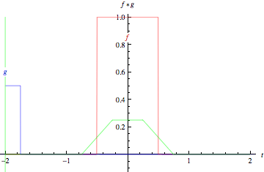
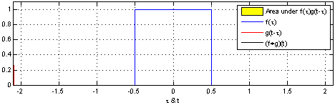
Convolution Integral:
Convolution of two continuous-time signals x(t) and h(t) is stated as
δ(t)
h(t)
Convolution integral
LTI system
x(t)
x(t)*h(t)
If the impulse response of an LTI system is known then its output can be found for any other input signal through the convolution
BLG354E - İTÜ Faculty of Computer Engineering and Informatics - Üstündağ

Slide 10

Convolution Algorithm:
By applying the commutative property of convolution to
we get →
Step 1: Impulse response h(τ) is reflected about the origin (time-reversed) to obtain h(-τ) and then shifted by t to form h(t-τ) = h[-(τ-t)] which is a function of T.
Step 2: h(t-τ) and the signal x(τ) and are multiplied together for all values of τ with fixed t.
Step 3: “x(τ )h(t-τ)” is integrated over all T and that yields a single output value y(t)
Step 4: Steps 1 to 3 are repeated as t varies over -∞ to +∞ to calculate the total convolution as y(t).
BLG354E - İTÜ Faculty of Computer Engineering and Informatics - Üstündağ

Slide 11
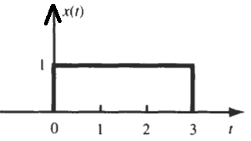
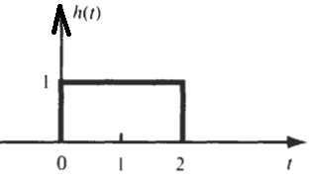








Example:
Find y(t)=x(t)*h(t ) for x(t) and h(t) shown below
x(t)=u(t)-u(t-3)
h(t)=u(t)-u(t-2)
BLG354E - İTÜ Faculty of Computer Engineering and Informatics - Üstündağ

Slide 12


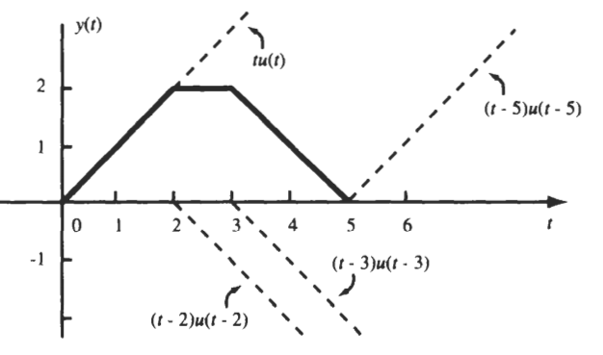
BLG354E - İTÜ Faculty of Computer Engineering and Informatics - Üstündağ

Slide 13
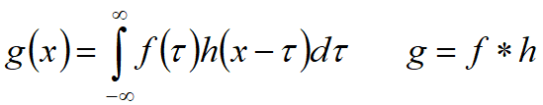
Kernel in convolution
Convolution is linear and shift invariant
kernel h
Output has a duration longer than the input indicates that convolution often acts like a low pass filter and smooths the signal.
BLG354E - İTÜ Faculty of Computer Engineering and Informatics - Üstündağ

Slide 14
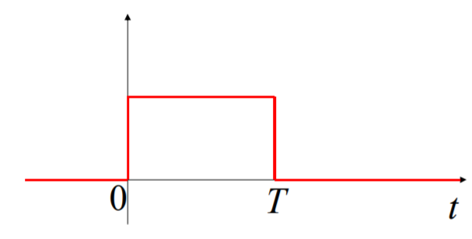
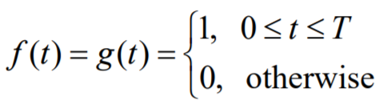
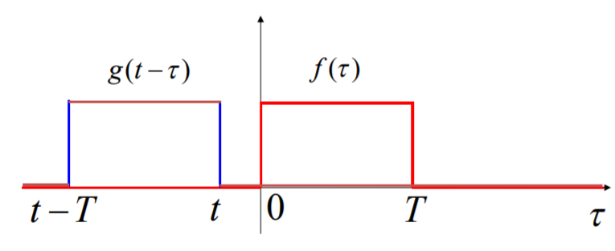
Graphical Convolution:
Suppose that f(t) = g(t) where f(t) is the rectangular pulse depicted in figure, of height 1.
For t<0 :
BLG354E - İTÜ Faculty of Computer Engineering and Informatics - Üstündağ

Slide 15
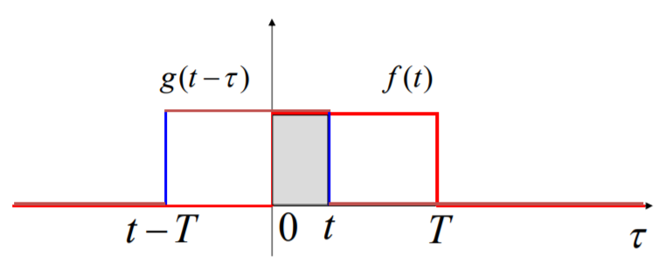
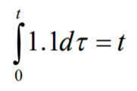
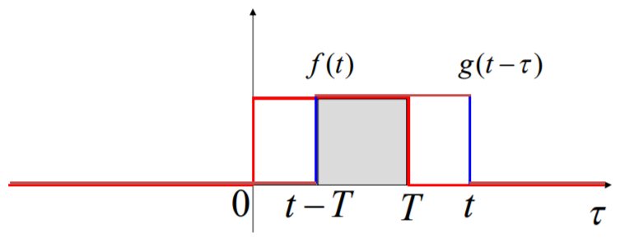
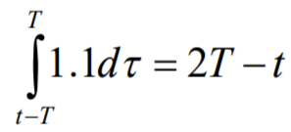
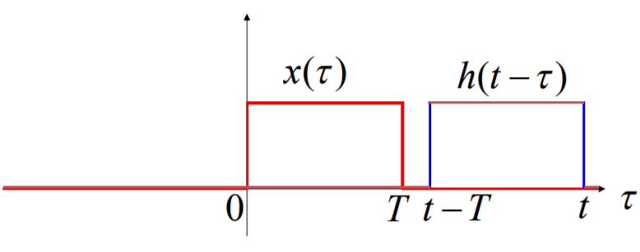
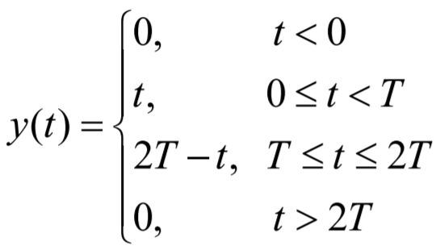
For 0≤t<T :
For T≤t≤ 2T :
For 2T<t :
BLG354E - İTÜ Faculty of Computer Engineering and Informatics - Üstündağ

Slide 16
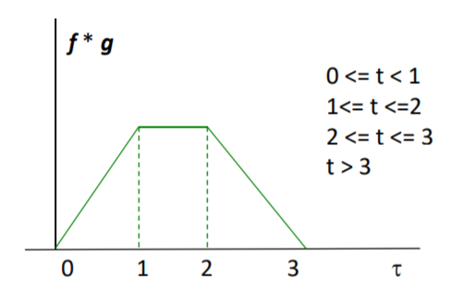
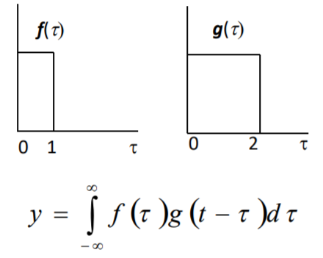
Example:
*
BLG354E - İTÜ Faculty of Computer Engineering and Informatics - Üstündağ

Slide 17
Example:
Find the convolution between a(x) and b(x)
1
1
x
x
-1
1
-1
1
1
-2
-1
1
2
BLG354E - İTÜ Faculty of Computer Engineering and Informatics - Üstündağ

Slide 18

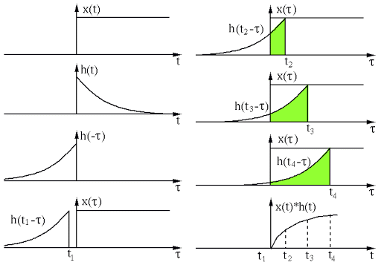


Example:
Impulse response h(t) of a continuous time LTI system is given by
α>0
Find output of the system y(t) for
x(t)=u(t)
Ref: http://fourier.eng.hmc.edu/e161/lectures/convolution/index.html
BLG354E - İTÜ Faculty of Computer Engineering and Informatics - Üstündağ

Slide 19

Convolution properties:
Commutativity:
Associativity:
Distributivity:
Time-Frequency Domain Transformation:
x₁(t)*x₂(t) ↔ X₁(ω)·X₂(ω)
This will be proven after introduction of the Fourier Transform
BLG354E - İTÜ Faculty of Computer Engineering and Informatics - Üstündağ

Slide 20





Proof:
Prove the commutativity property of convolution for DT signals
Variable change:

Slide 21
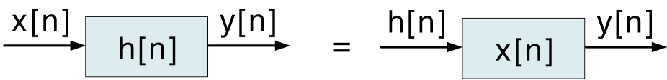
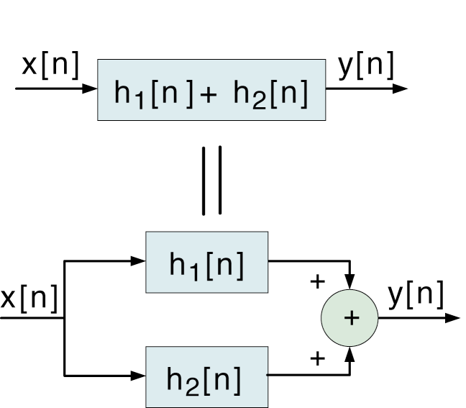
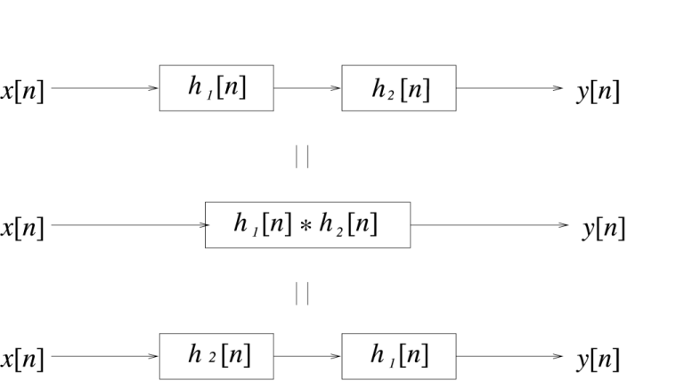
Implications of the Convolution Properties
Implications:
Commutative:
Distributive:
Associative:
BLG354E - İTÜ Faculty of Computer Engineering and Informatics - Üstündağ

Slide 22


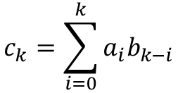
Convolution of discrete time signals:
Output of any discrete-time LTI system is the convolution of the input x[n] with the impulse response h[n] of the system
δ[n]
h[n]
LTI system
Convolution sum
x[n]
x[n]*h[n]
Example:
x[n]={1, 0, 2, 1} and y[n]={2, 0, 1} are two DT signals. Find their convolution c[n]=x[n]*y[n]
x₀ x₁ x₂ x₃
y₀ y₁ y₂
$$c_{k}=\sum_{i=0}^{k}{a_{i}b_{k−i}}$$
x:
1
0
2
1
y:
2
0
1
c[n]={2, 0, 5, 2, 2, 1}
1
0
2
1
1
0
2
1
1
0
2
1
1
0
2
1
0
2
1
0
2
1
2
1
2
0
5
2
2
1
c₀ c₁ c₂ c₃ c₄ c₅
c₀ c₁ c₂ c₃ c₄ c₅
c₀ c₁ c₂ c₃ c₄ c₅
BLG354E - İTÜ Faculty of Computer Engineering and Informatics - Üstündağ

Slide 23
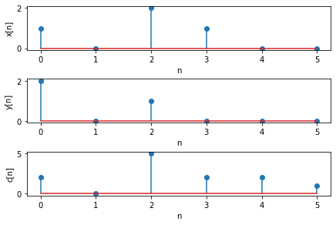
Convolution in Python :
c=np.convolve (x, y, mode)
import numpy as np
import matplotlib.pyplot as plt
x,y=[1,0, 2, 1], [2,0, 1]
c=np.convolve(x, y)
n=np.arange(0,(len(c)))
print("convolution: x[n]*y[n]=",c)
plt.subplot(3,1,1);
plt.xlabel('n');
plt.ylabel('x[n]');
# zero padding for plot of x[n]
xp=np.pad(x, (0,(len(c)-len(x))), 'constant')
plt.stem(n, xp);
plt.subplot(3,1,2);
plt.xlabel('n');
plt.ylabel('y[n]');
# zero padding for the plot of y[n]
yp=np.pad(y, (0,(len(c)-len(y))), 'constant')
plt.stem(n, yp);
plt.subplot(3,1,3);
plt.xlabel('n');
plt.ylabel('c[n]');
plt.stem(n, c);
plt.tight_layout(pad=0.5)
plt.show()
mode is optional: {‘full’, ‘same’, ‘valid’}
Size of c: len(c)=(len(x)+len(y)-1)
BLG354E - İTÜ Faculty of Computer Engineering and Informatics - Üstündağ

Slide 24
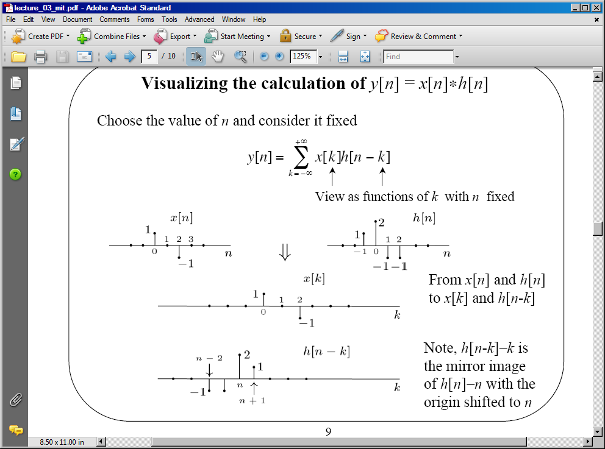
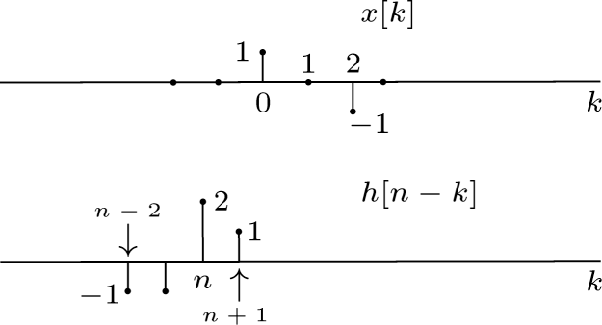
Example:
Find convolution of x[n] and h[n] by graphical shifting the h[n] over x[n]
BLG354E - İTÜ Faculty of Computer Engineering and Informatics - Üstündağ

Slide 25
Graphical Convolution Example (1/2)
2
1
-1
-1
1
-1
k = -6 -5 -4 -3 -2 -1 0 1 2 3 4 5 6 7 8 9

Slide 26
Graphical Convolution Example (2/2)
2
1
-1
-1
1
-1
* Duration of x[n] : L_{x} = 3 samples
* Duration of h[n] : L_{h}=4 samples
* Duration of y[n] : L_{y} = L_{x} + L_{h} – 1
k = -6 -5 -4 -3 -2 -1 0 1 2 3 4 5 6 7 8 9

Slide 27
Examples of Discrete Time Convolution
Example: delayed unit-pulse
Example: unit step
Example: integration
Example: unit-pulse

